Slide 1

InduSkill
..a site to help Industries & skills
Project Documentation….
Team members:
Siddhi Mishra
Vanshika Bagri
Mohammad Zeeshan

Slide 2

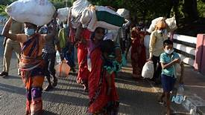
Problem Statement:
Description:
Due to Covid ,millions of workers in India have had to migrate from their work. However, now, when the country goes into an unlock phase, it’s a challenge for industries to find skilled workers for their industry as well as for workers having basic labour skills like sewing/welding/mechanics etc.
Taking the current situation in mind, we have existing system where educated people can apply but for the workers having skills like this, they have only one way to go: to middleman(agent) who takes hefty commissions from them. Also, industries have to charge those people to get some workers.

Slide 3
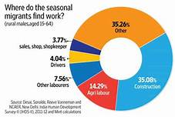
"For India, the report estimates job loss for 4.1 million youth. Construction and agriculture have witnessed the major job losses among seven key sectors," said the ILO-ADB report, titled 'Tackling the COVID-19 youth employment crisis in Asia and the Pacific', released on Tuesday. The young people's employment prospects in Asia and the Pacific are severely challenged due to the pandemic, it added.
out of 10 workers lost jobs in urban India during lockdown: Azim Premji University survey 12 May, 2020,
Case Study(of current scenario)

Slide 4

Proposed Solution:
(provide platform to connect the industries to skilled workers)
We propose to build a website Induskill( industry & skill) as follows:The main objective of the project is to change manual way of operation of the job application to an automatic system. We are planning to design a platform to provide help and support to skilled workers to find suitable industries with their preferred location and salary. Additionally, we provide assistance to industries to find workers with appropriate skill sets. Our aim is to provide a connection between industries and skilled workers. We also invite NGOs and government organisations to collaborate with us in our mission.Our web application “Induskill” provides an easy and convenient search application for the job seekers to find their desired jobs and for the recruiters to find the right candidate.

Slide 5
Software Architecture :
Company
Job Seeker
Chosen skill
Company
Stored
Advanced filtering for job seekers
Stored
Registration Table
Match
Records Table
Details of candidate’s sent to Company representative/job seeker to get job update
SMS notification for the job seeker.
SMS Module
(YES/NO)

Slide 6
SOFTWARE Requirements
Purpose
The purpose of Software Requirements Specification (SRS) document
is to describe the external behavior of the Online Job Portal System.
Requirements Specification defines and describes the operations,
interfaces, performance, and quality assurance requirements of the System.
Scope
The Software Requirements Specification captures all the requirements in
a single document. The Online Skill- Employment Portal System that is to
be developed provides the workers/labourers with employment
information, online applying for jobs and many other facilities.

Slide 7
Functional Requirements
Our Online Skill- Employment Portal System is supposed to have the following
features.
-Post Job/Delete Job/find candidate [organisation Area]
-Want job/search job/manage availability[employment seeker Area]
-Manage /Update/Notify[Administrator Area]
Therefore we have:
Modules:
•User Module
•Company Module
•Admin Module
,having following Characteristics:
•The “User” is expected to be internet familiar and to be able to use the job portal.
•The “Admin” is expected to be familiar with internet and database.

Slide 8
Express Server
HTML
CSS
Bootstrap
JQuery
Mongoose
NodeJS/MySql (Backend)
Software Requirement:

Slide 9
HARDWARE REQUIREMENT
CPU | Pentium Dual Core
Processor Speed | 2.2 GHz
Coprocessor | Built IN
Total RAM | 2 GB
Hard Disk | 320 GB
Keyboard | 105 Keys
Mouse | Logitech Mouse
Display | SuperVGA

Slide 10

Security:
The job portal will provide restriction against unauthorized
access.
Safety:
There will be a backup of data for any future mishap.
Performance:
The online job portal will never break down and work consistently.
Link For SRS Document!!
Non-Functional Requirements

Slide 11
Milestones
Build Tech Stack
Backend Development
Testing & Submission
Design frontend
Work on technical stack required to attain website goal.
Translate text within an app
1st phase |  |  |  | 2nd phase
Test the website for some demo data and submit the project
Based on the idea,create outlet of project

Slide 12
Website flow proposed:
Firstly, a candidate looking for a job or NGO/govt org fills details and similarly industries also can post their requirements on our website.
We are also planning to send the details of industries in which people are eligible on their phone via sms.
Firstly, a candidate looking for a job or NGO/govt. org fills details and similarly industries also can post their requirements on our website.
We provide recommendations according to skill/location and provide industries with details of people's having those skills
We are also planning to send the details of industries in which people are eligible on their phone via sms.

Slide 13
ENTITY- RELATIONSHIP DIAGRAM
An Entity Relationship (ER) Diagram is a type of flowchart that illustrates how “entities” such as people, objects or concepts relate to each other within a system.

Slide 14
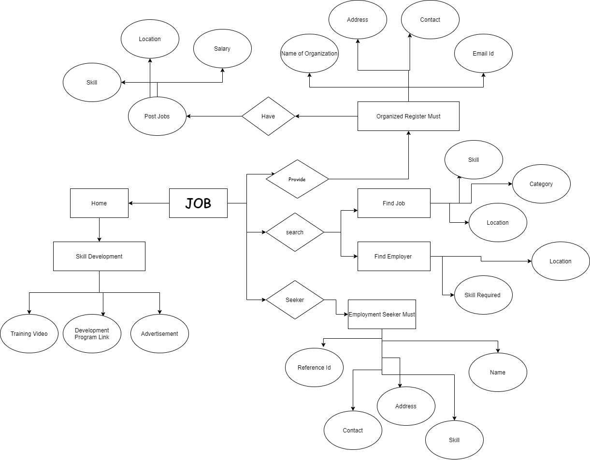

Slide 15
DATA FLOW DIAGRAM LEVEL - 0
(A level 0 data flow diagram (DFD), also known as a context diagram, shows a data system as a whole and emphasizes the way it interacts with external entities.)

Slide 16
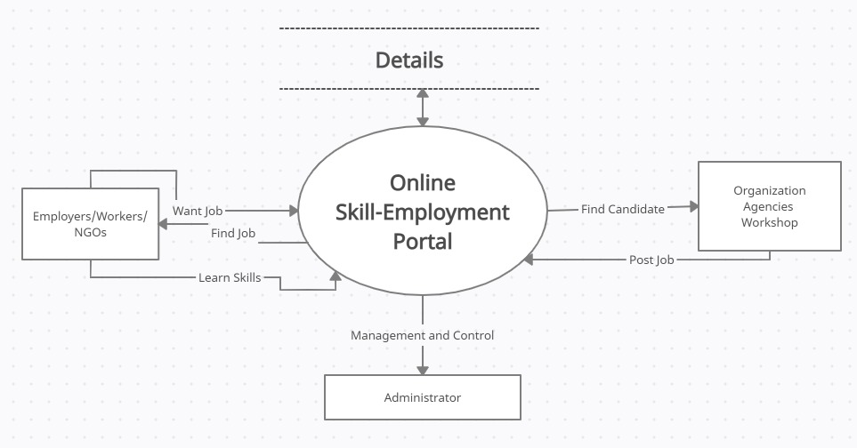

Slide 17
DATA FLOW DIAGRAM LEVEL - 1
(A level 1 data flow diagram (DFD) breaks down the main processes into subprocesses that can then be analyzed and improved on a more intimate level.)

Slide 18
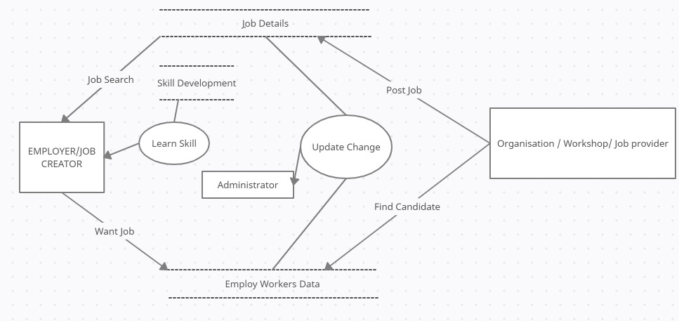

Slide 19
DATA FLOW DIAGRAM LEVEL - 2
(A level 2 data flow diagram (DFD) offers a more detailed look at the processes that make up an information system than a level 1 DFD does. It can be used to plan or record the specific makeup of a system.)

Slide 20
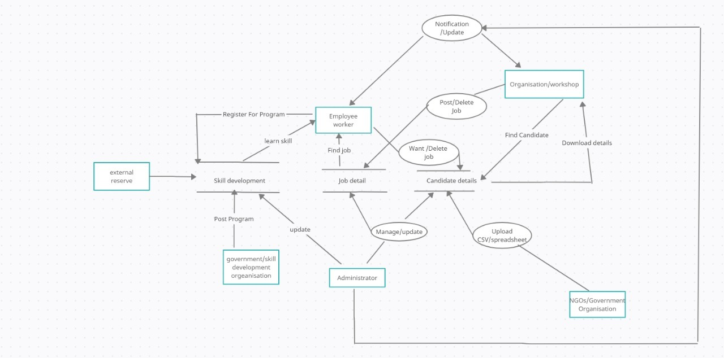

Slide 21
UML Diagrams
Use Case Diagram
Sequence Diagram
Activity Diagram
Class Diagram
Component Diagram

Slide 22
Use Case Diagram
(A use case diagram is a behavior diagram and visualizes the observable interactions between actors and the system under development.)

Slide 23
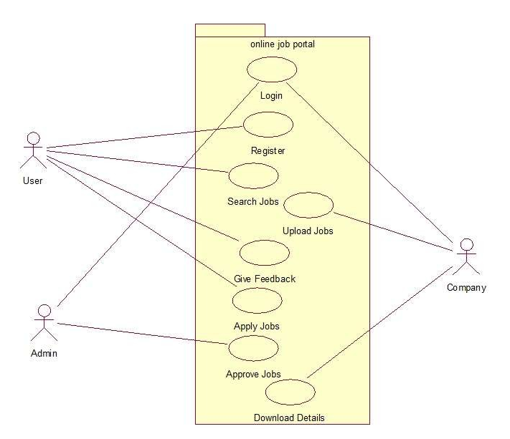
Authentication
Get Notification

Slide 24
Sequence Diagram
(A sequence diagram depicts the objects involved in the scenario and the sequence of messages exchanged between the objects needed to carry out the functionality of the scenario.)

Slide 25
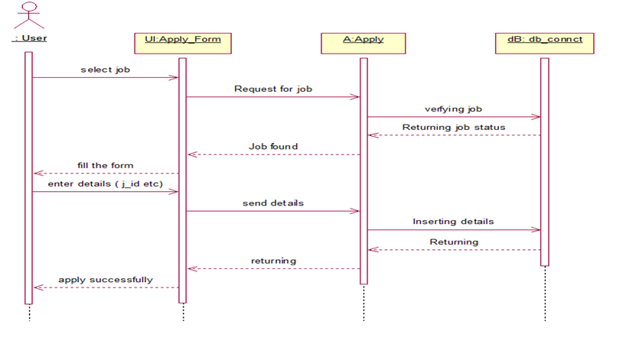
Post/Want Job
Set Job/Skill
Server
DB content

Slide 26
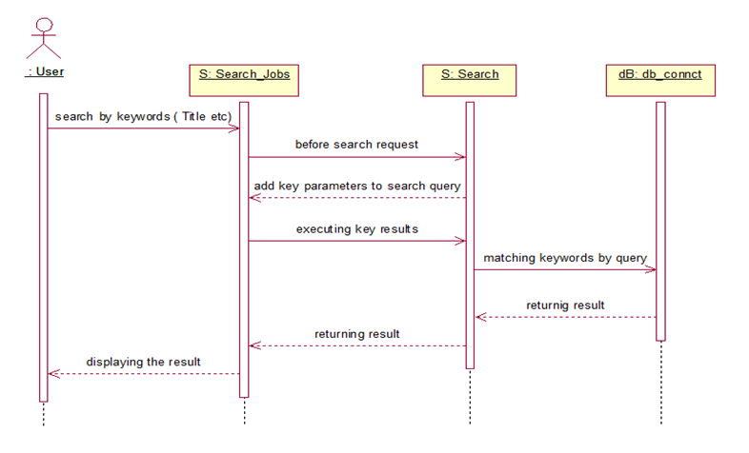
Search Job/Find Candidate

Slide 27
Activity Diagram
(Activity diagram is essentially an advanced version of flow chart that modeling the flow from one activity to another activity.)

Slide 28
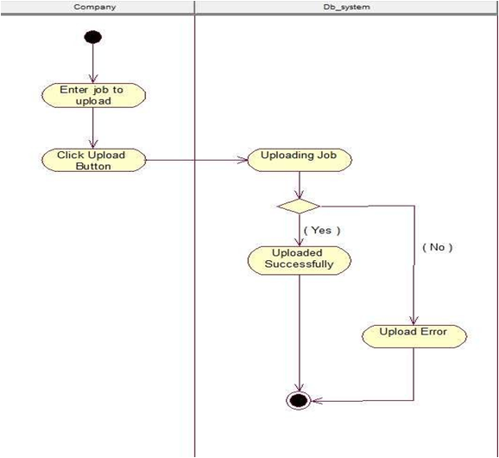
Post Job

Slide 29
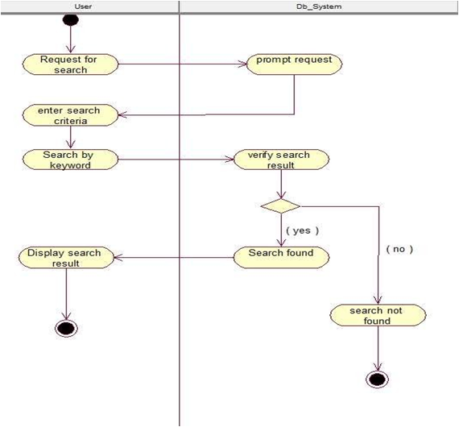
Search Job/Candidate

Slide 30
Class Diagram
(A class diagram describes the structure of a system by showing the system's classes, their attributes, operations, and the relationships among objects)

Slide 31
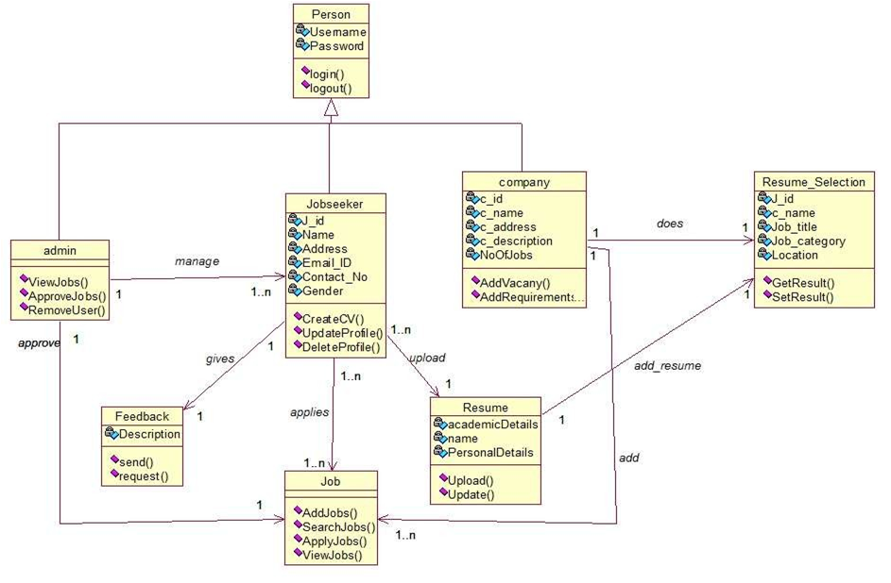

Slide 32
Component Diagram
(A component diagram describes the organization and wiring of the physical components in a system.)

Slide 33
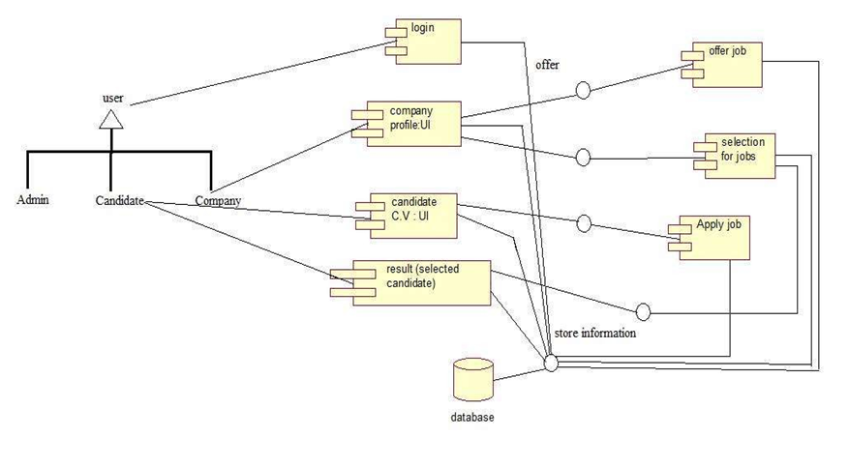
skills

Slide 34
Basic functionalities we have included in our prototype are following:
Regional language support.
Tab where industry and candidate search for job
Tab where candidate fill their data.
Tab where industry post their requirement.
Virtual assistant support using chatBot.
Tab where candidate learn different skills.
Prototype Link;
BASIC FUNCTIONALITIES :

Slide 35

Conclusion:
Unemployment is one of the adverse effect of post covid situation, and when it comes to lower grade skills workers like carpenter/welder etc. who have to migrate and lose their job as well as the small organisations which assist them , providing opportunities to them is one of the important responsibilities of government/NGOs. Building such platform which brings all these users on same platform is one of the crucial step toward betterment of their situation.
After analysing our prototype we realise to add following features to our website:
In ongoing phase of development we are planning to add following functionalities:
Develop a support from which job update sent to candidate phone via sms.
Develop text to speech chatBot and provide form filling ability to it so that user can search job /fill application for job using our assistant.
Collaborate with government organisation and NGO and provide and additional facility by which they can upload data in csv file and we can reach to candidate via phone sms.

Slide 36
THANKS!!

